Slide 1
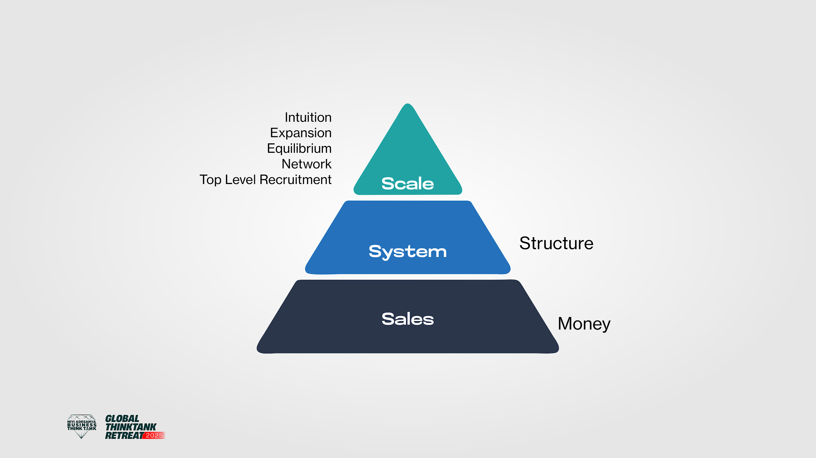

Slide 2


Slide 3
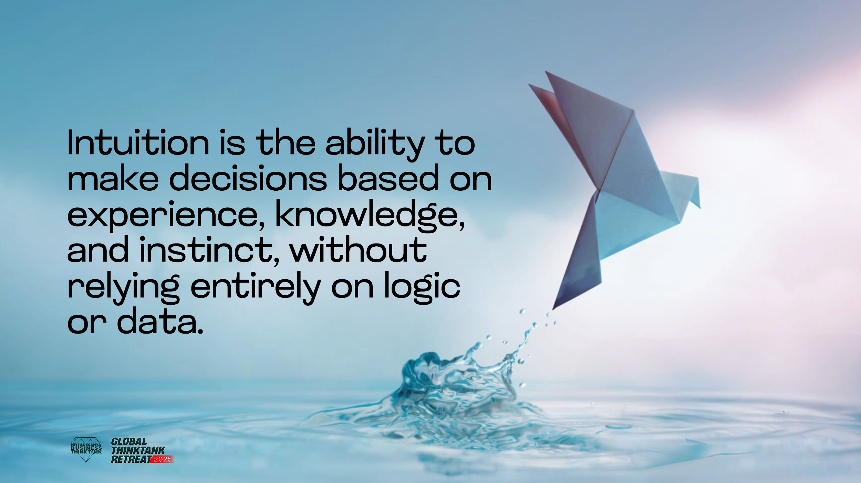

Slide 4
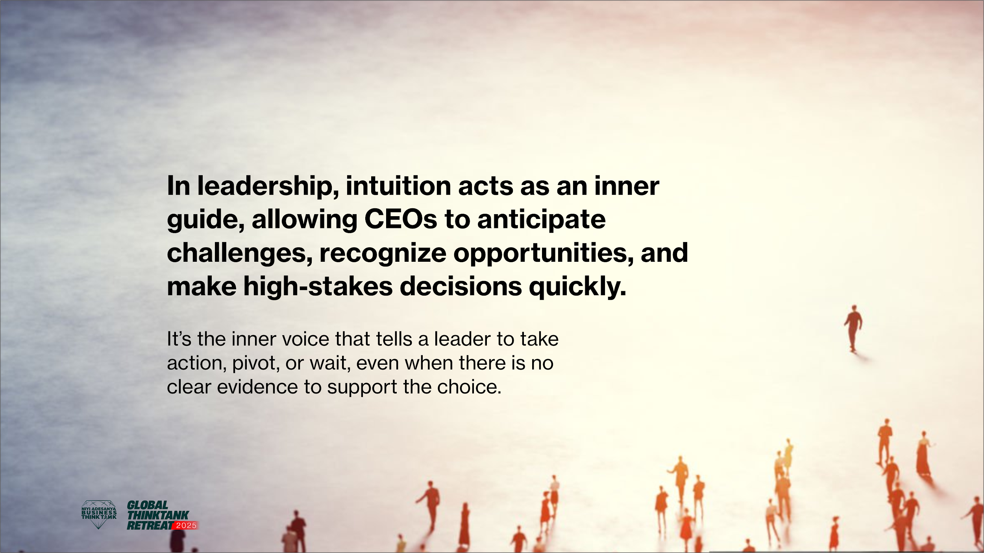

Slide 5
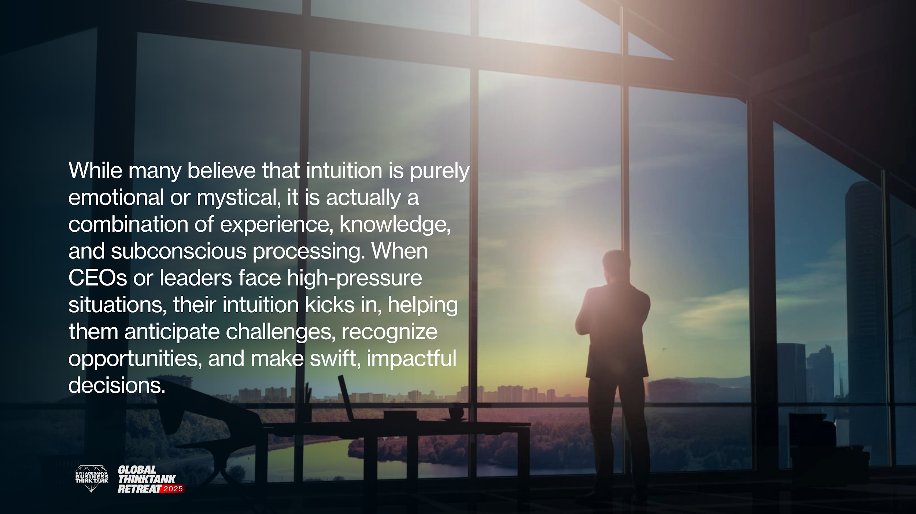

Slide 6
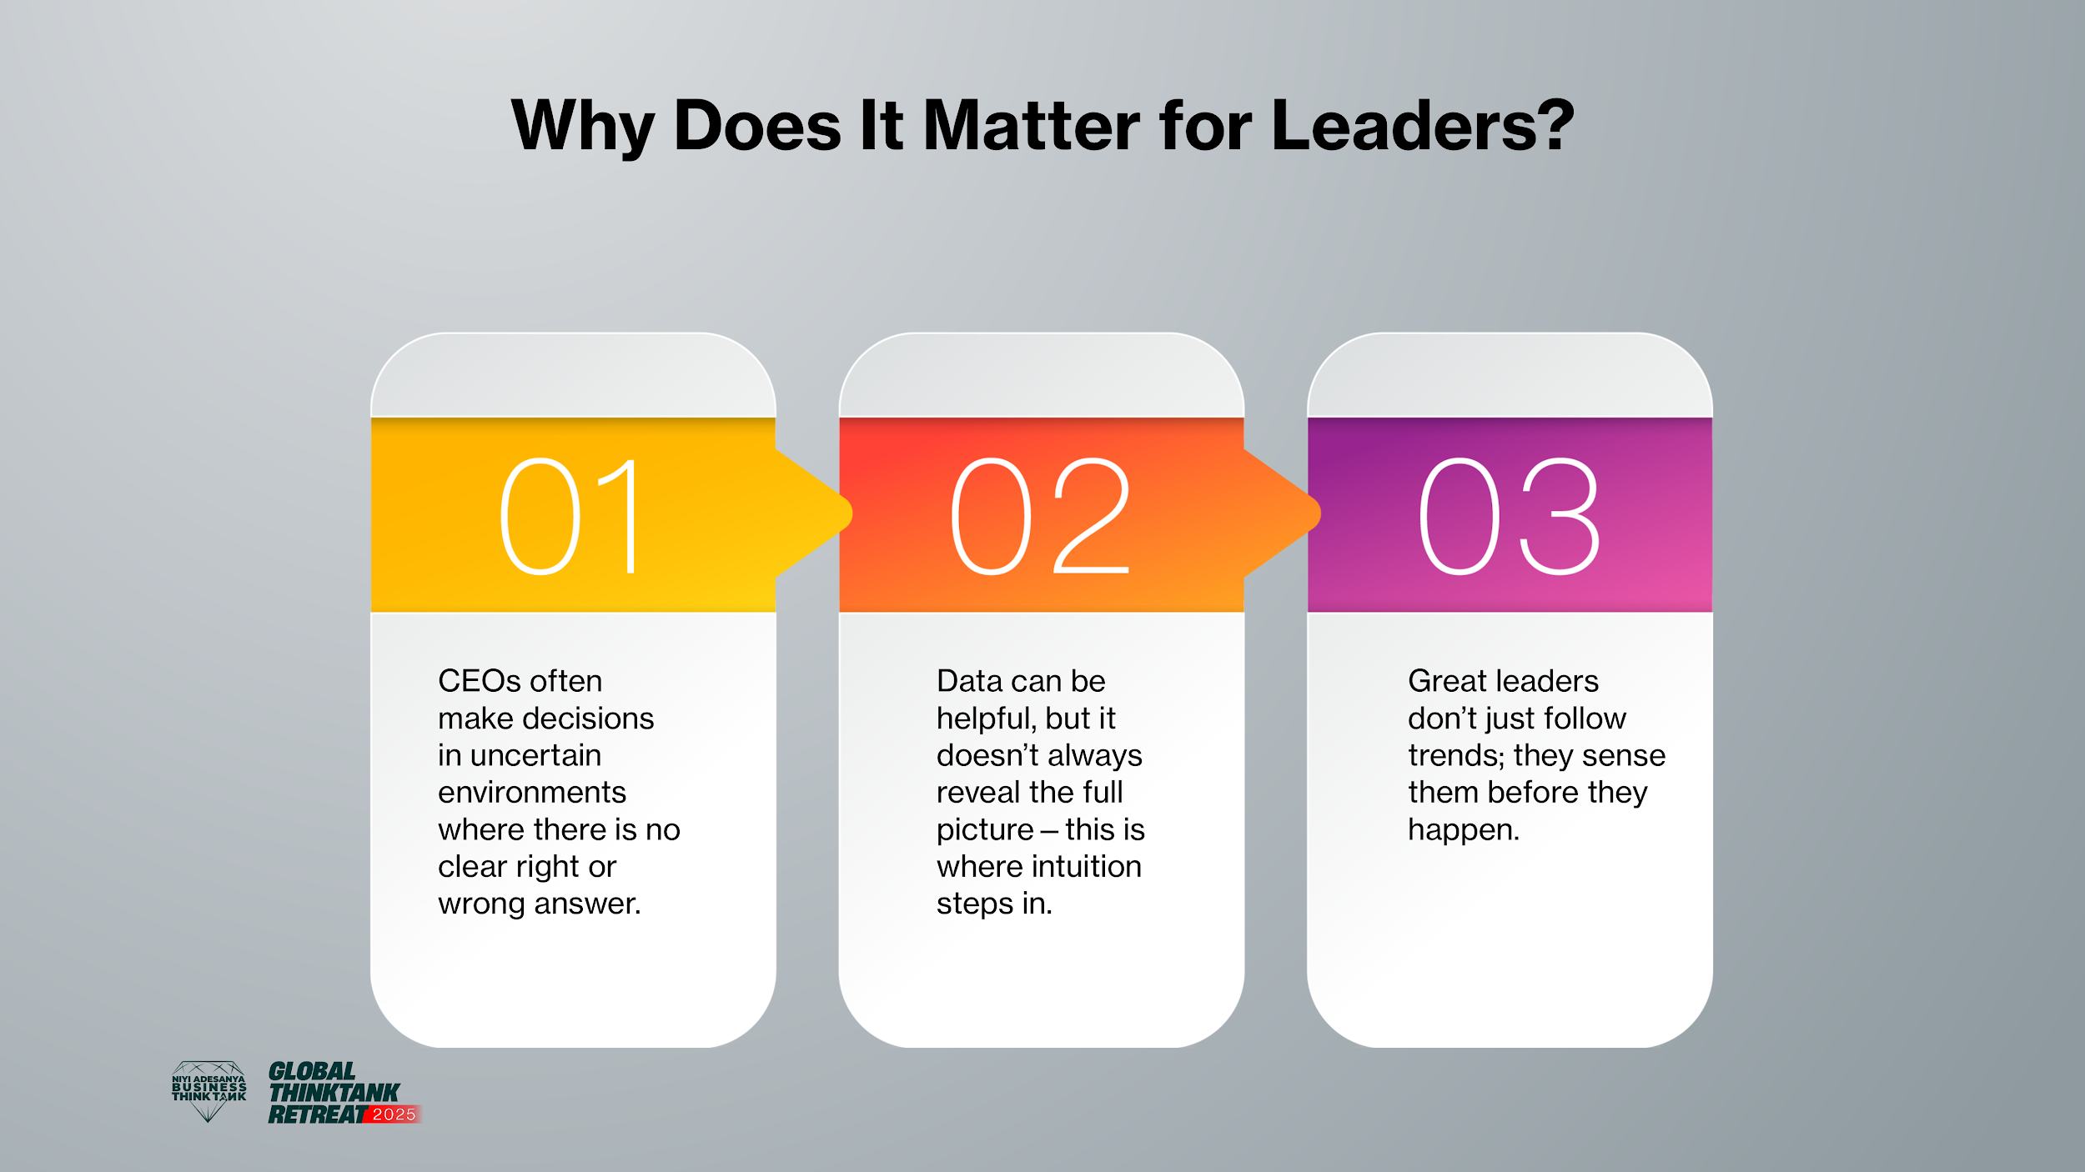

Slide 7
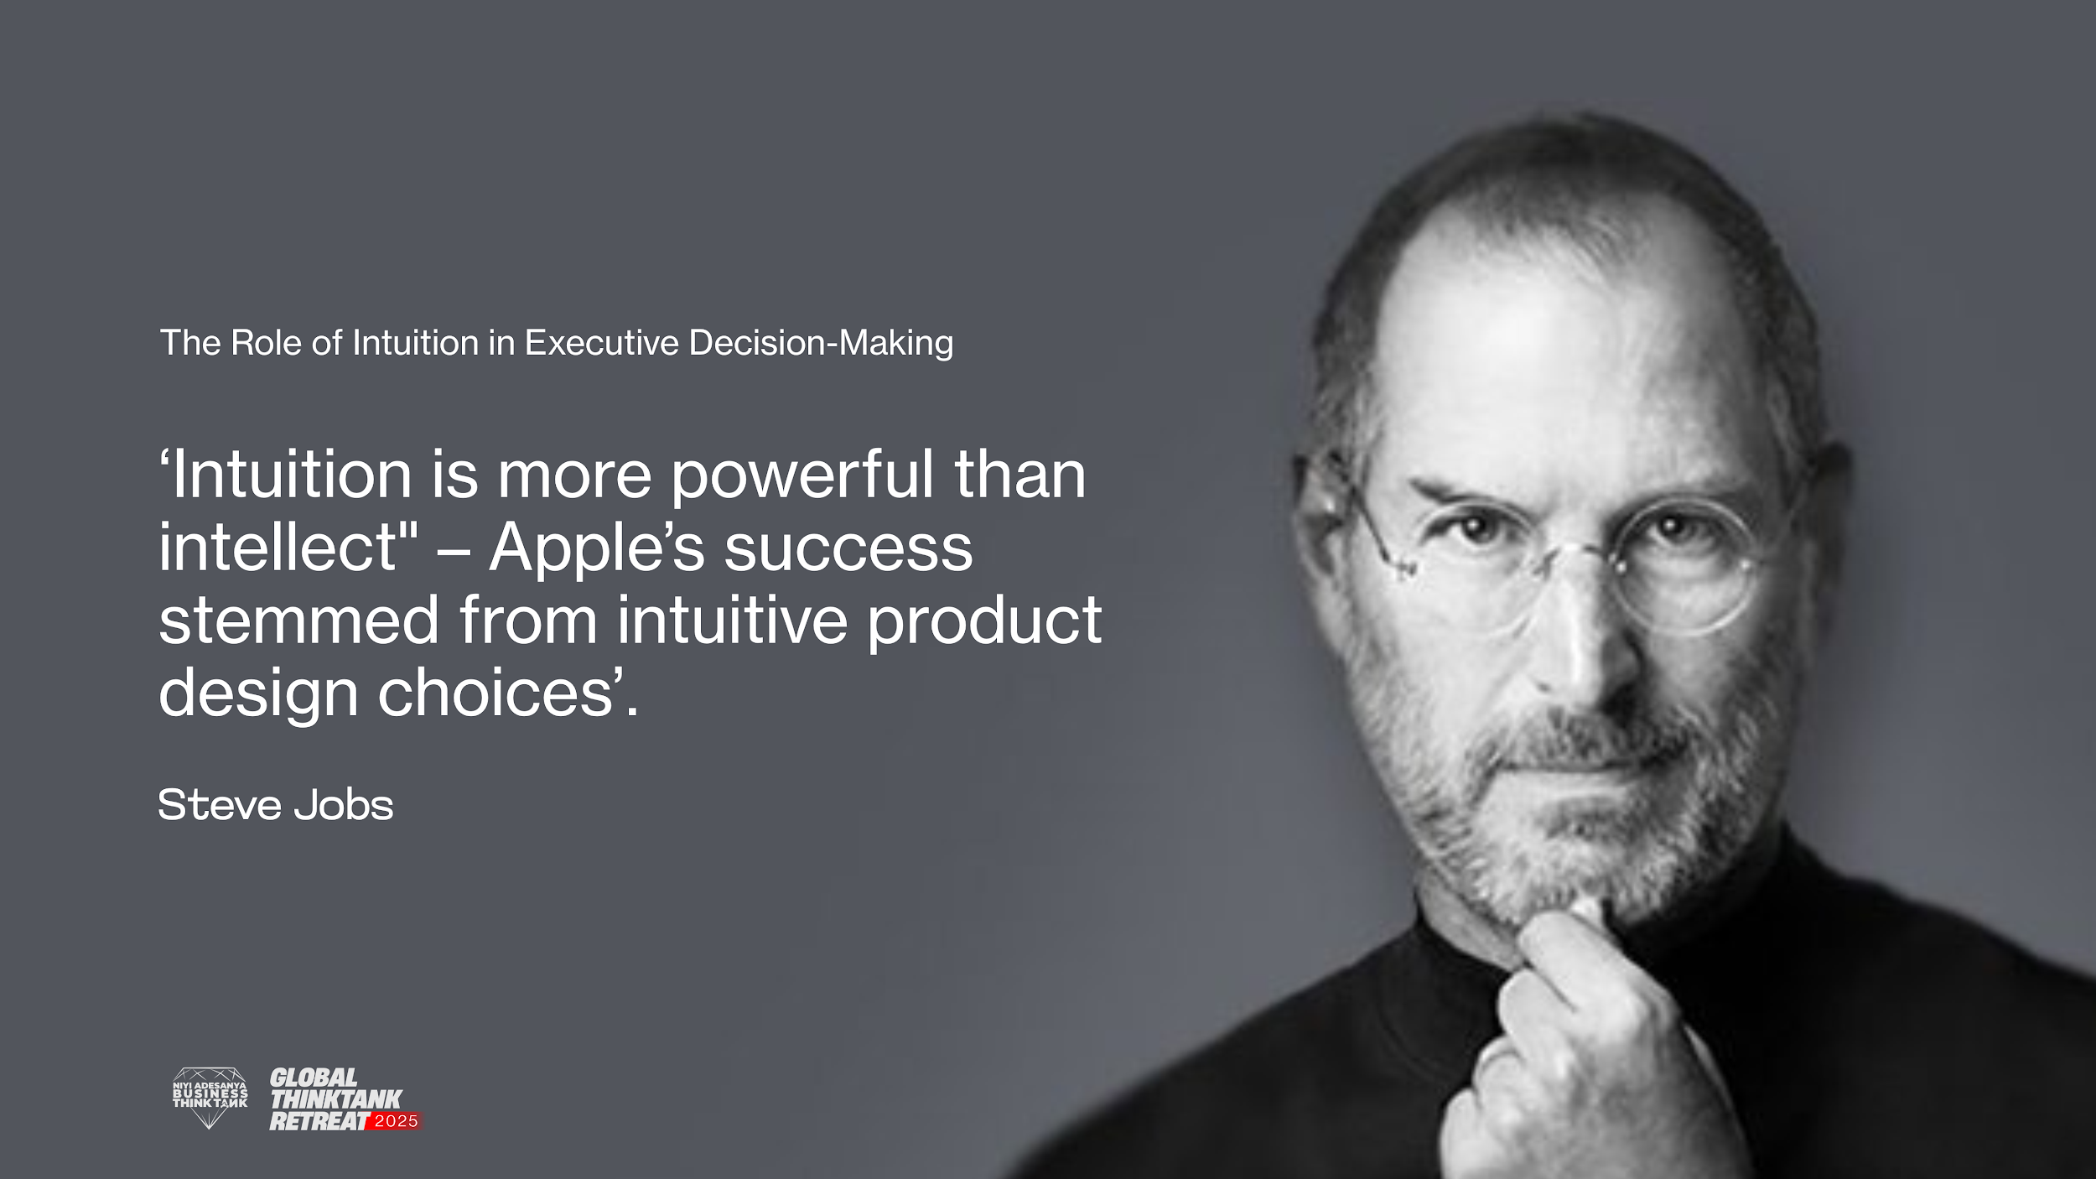

Slide 8
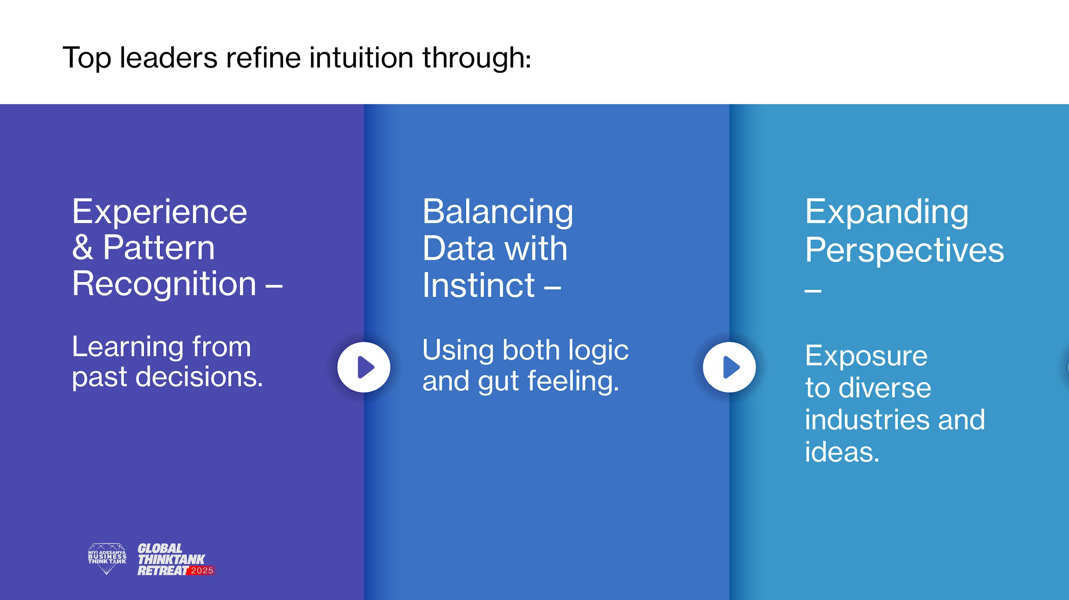

Slide 9
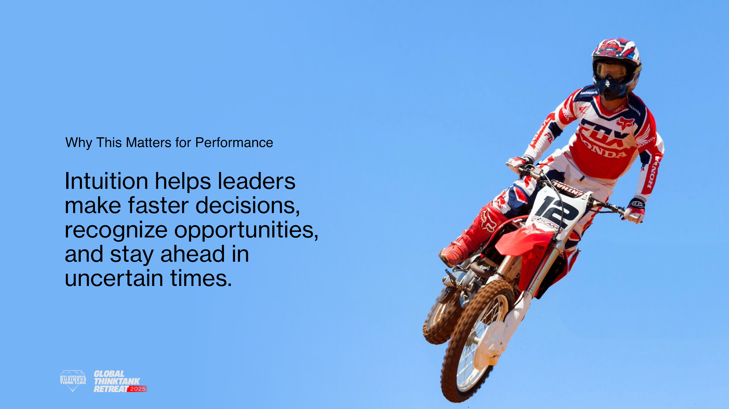

Slide 10
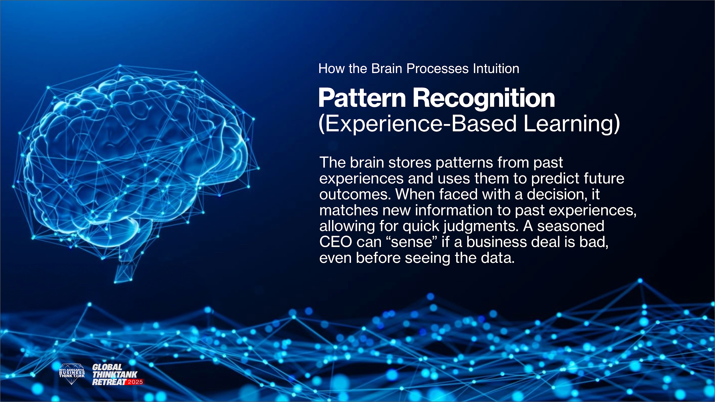

Slide 11
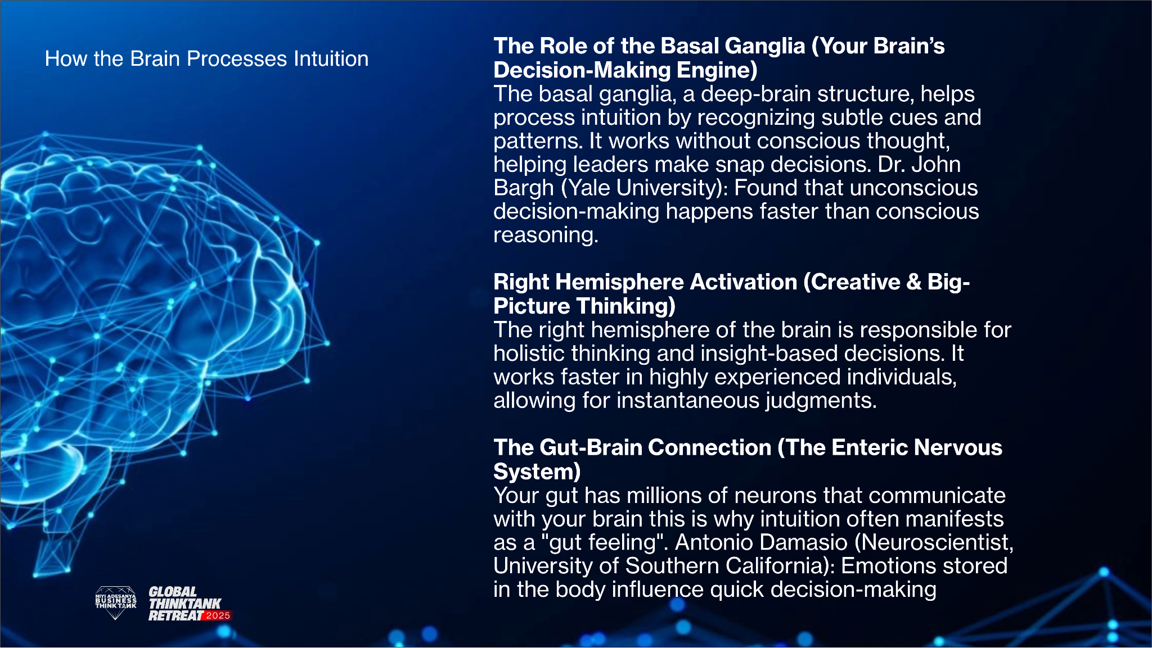

Slide 12
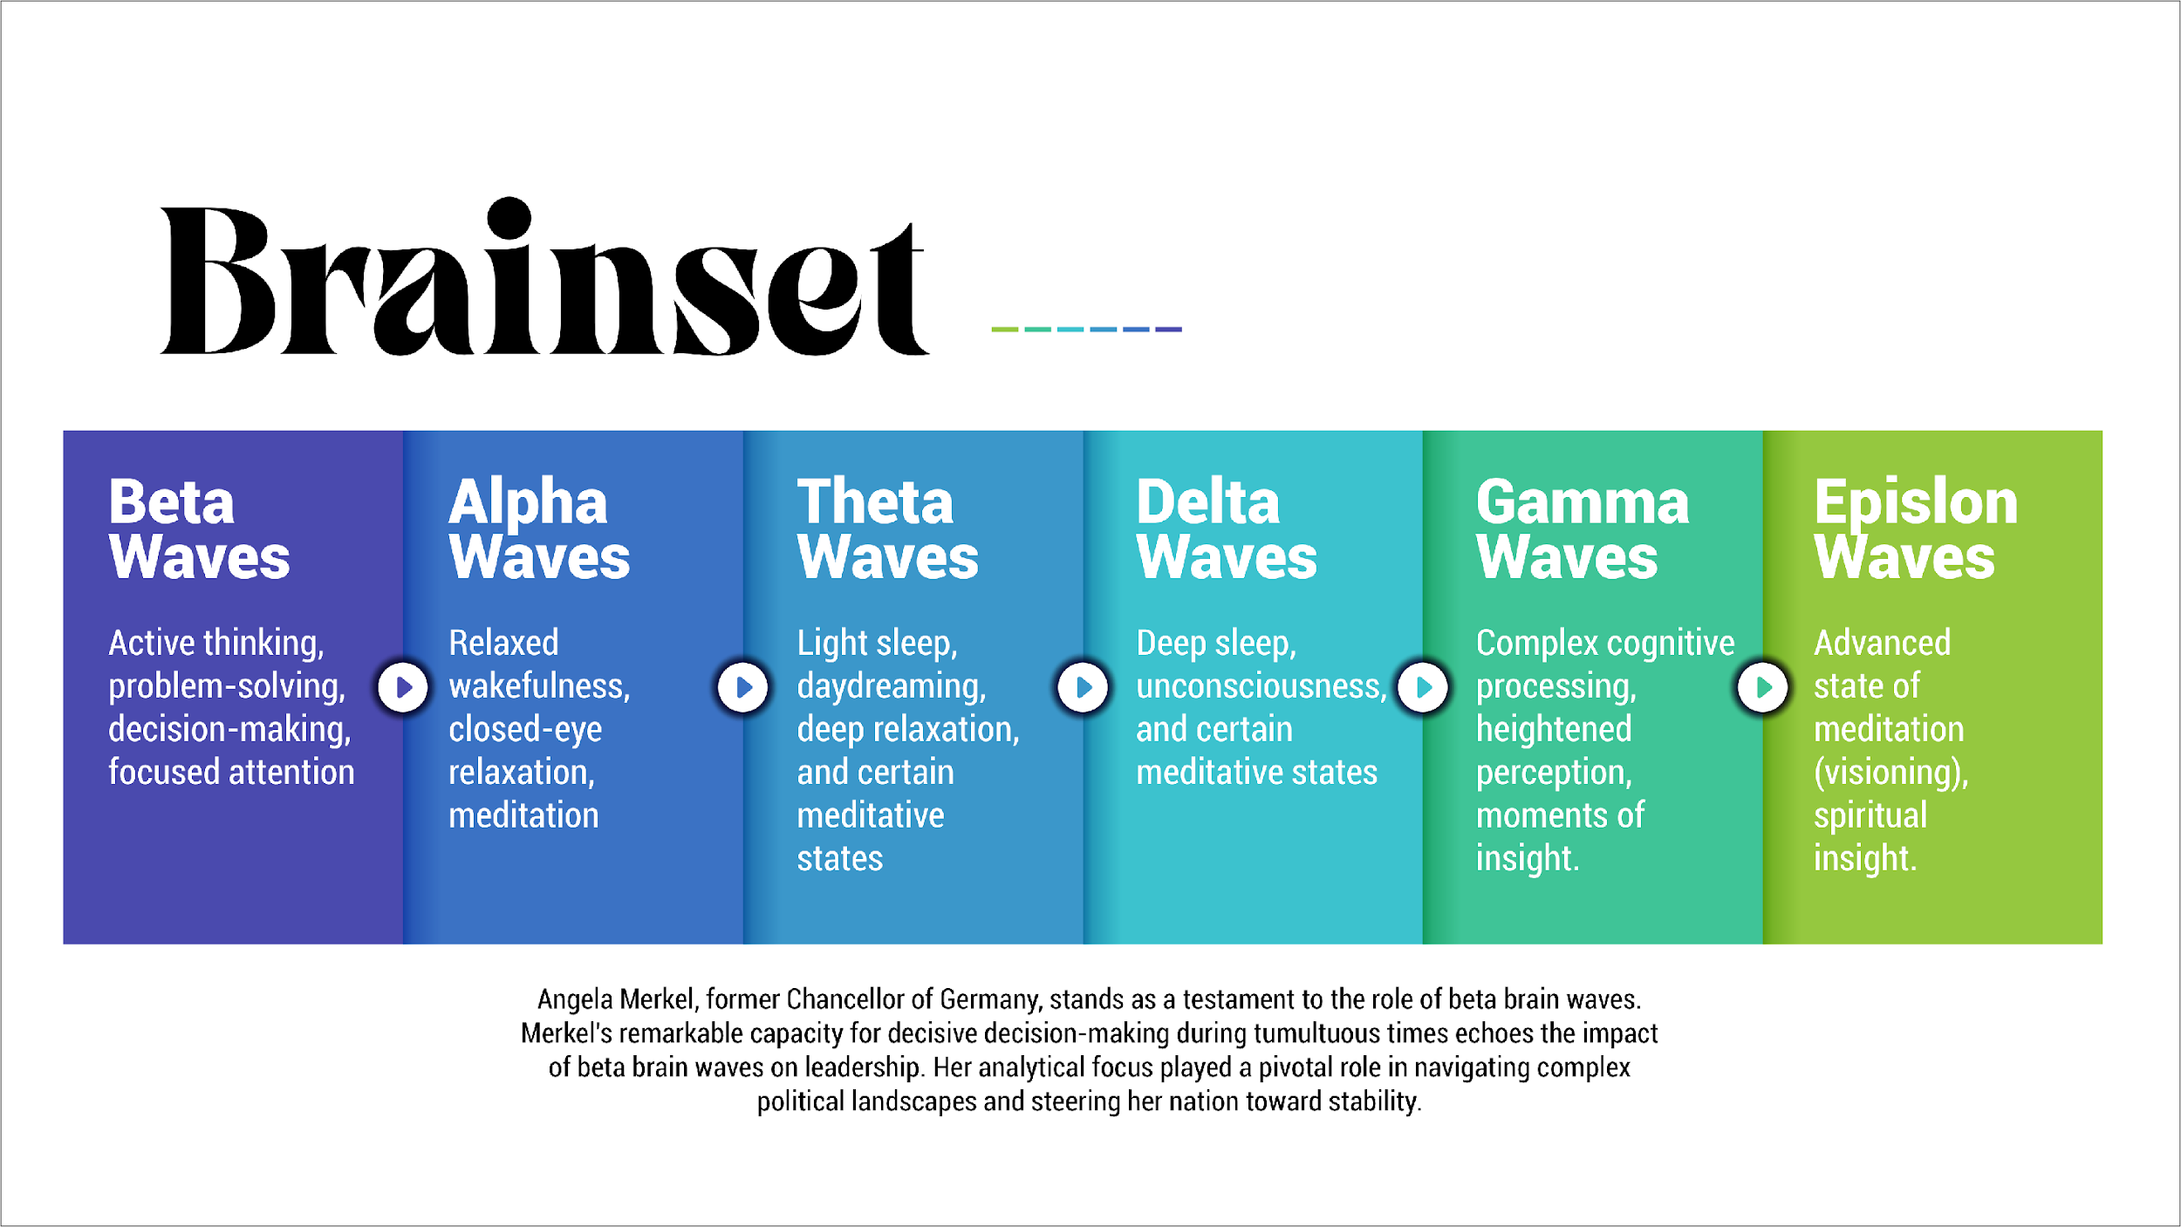


Slide 13
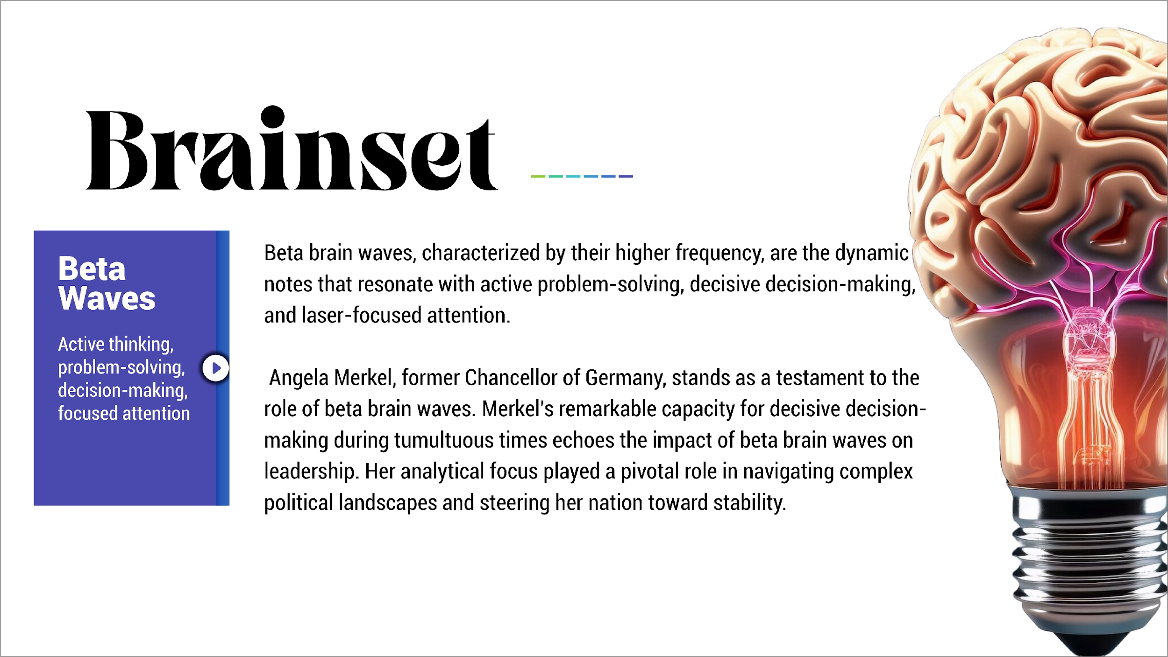

Slide 14
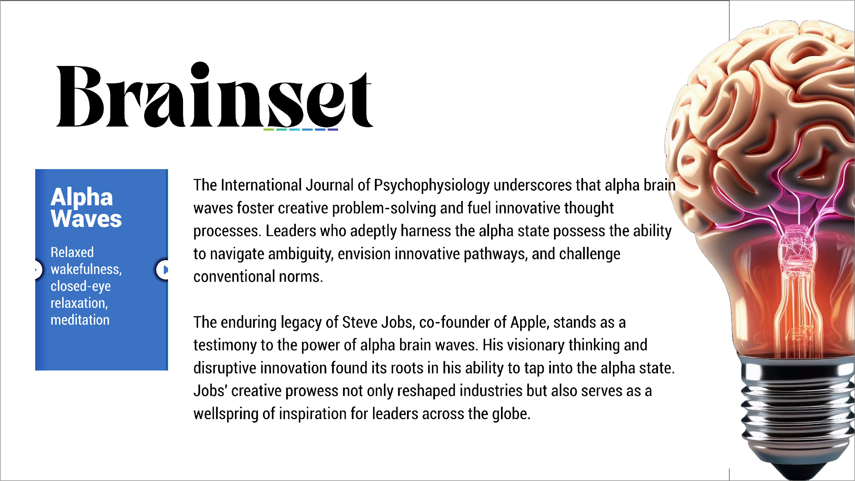

Slide 15
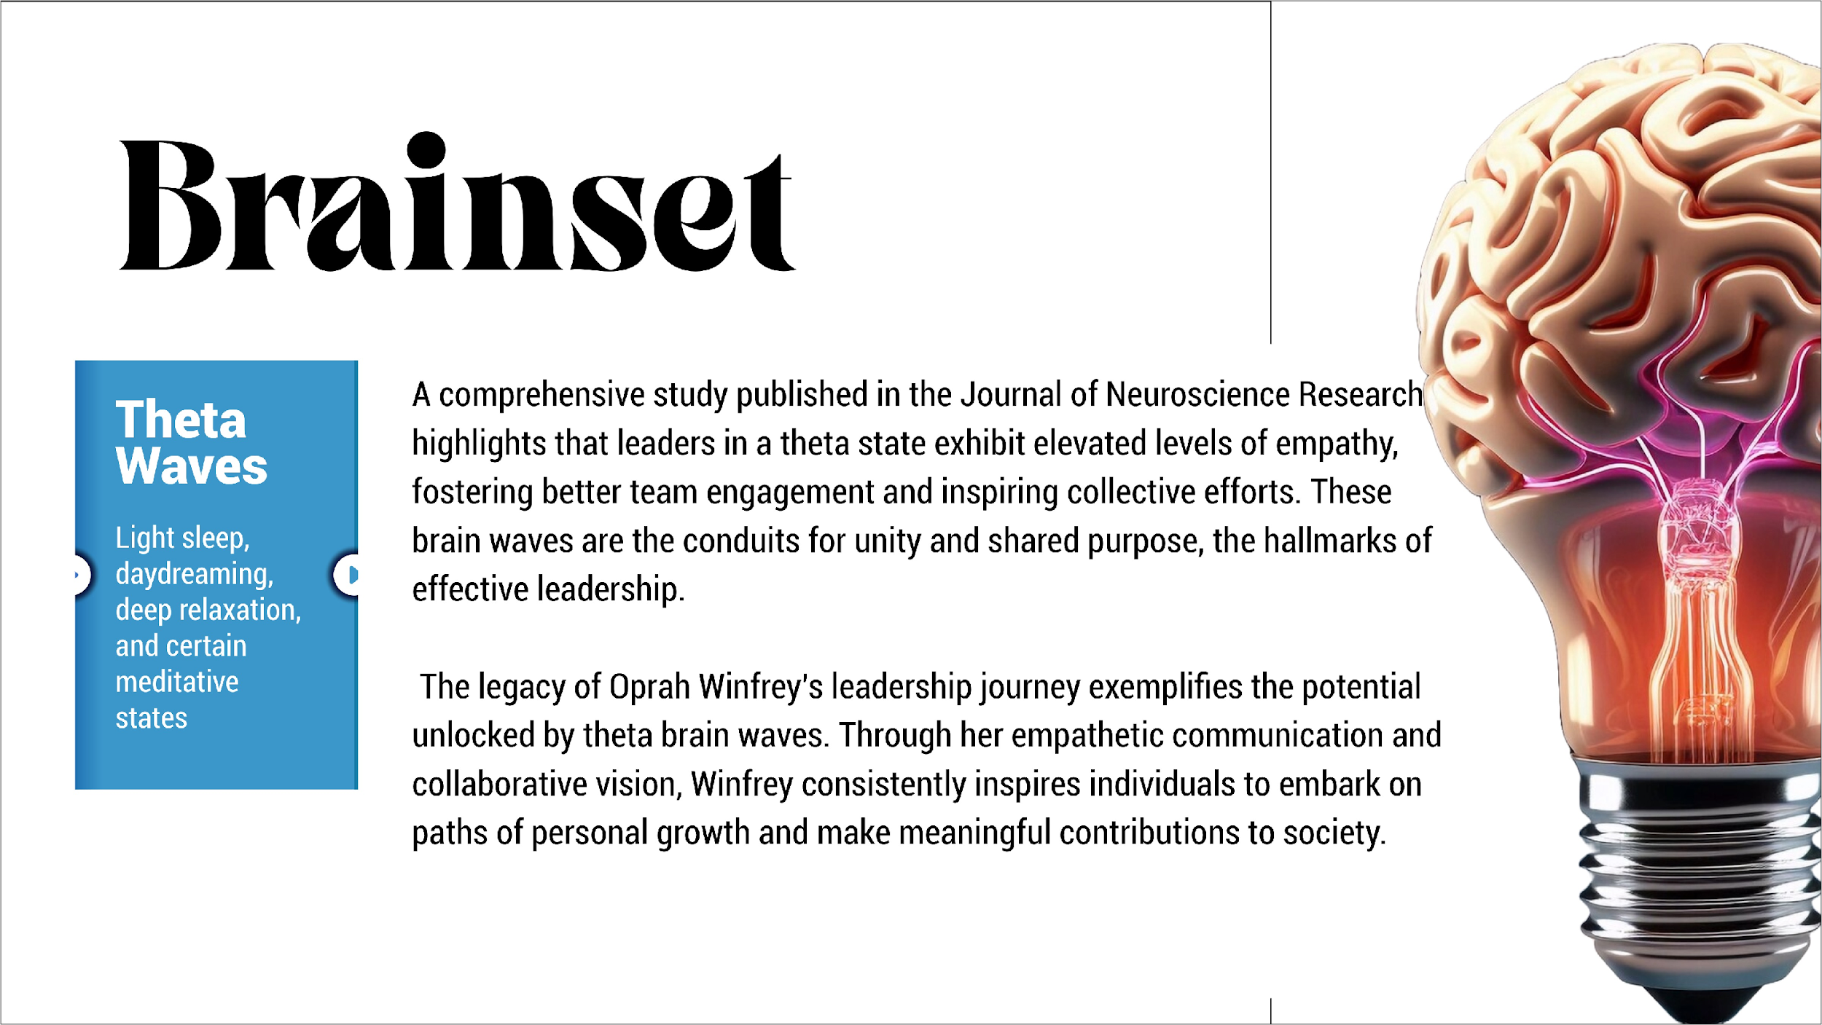

Slide 16
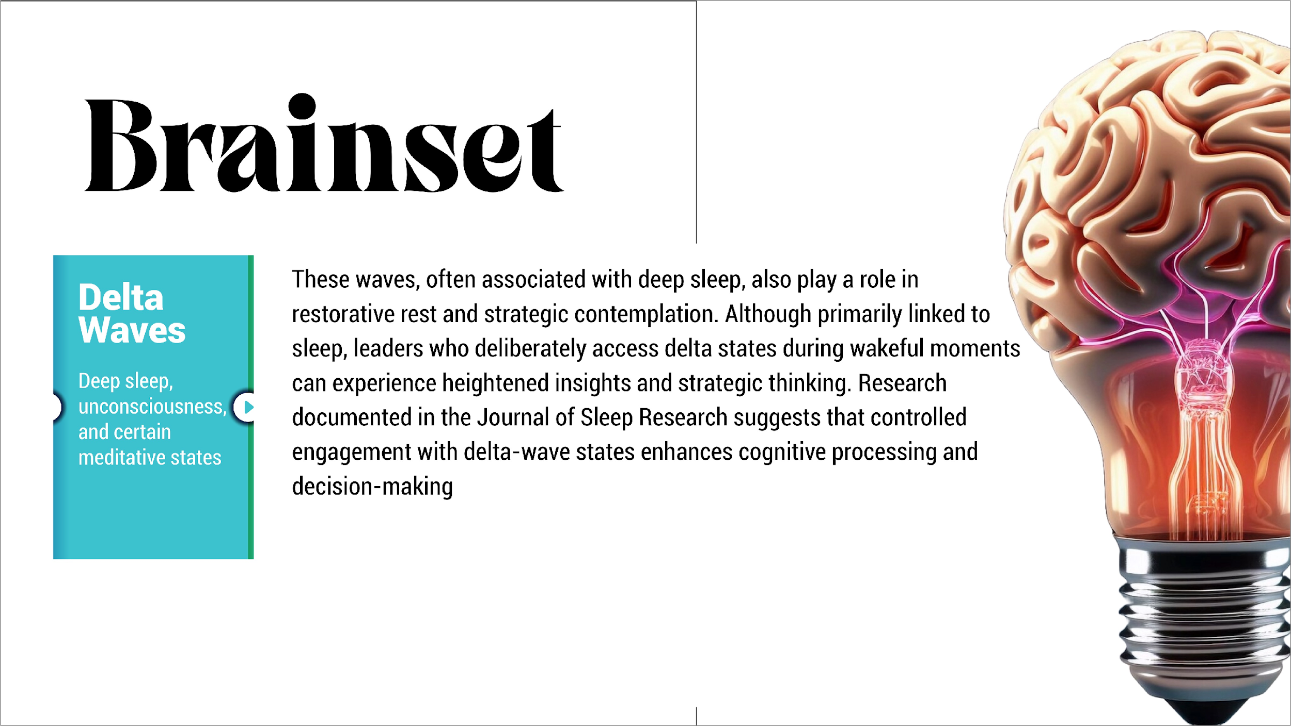

Slide 17


Slide 18
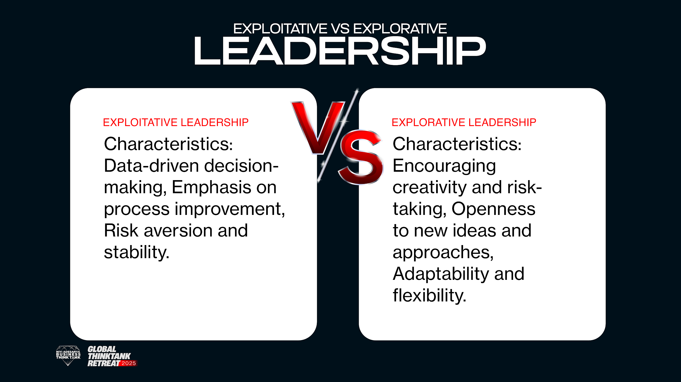

Slide 19
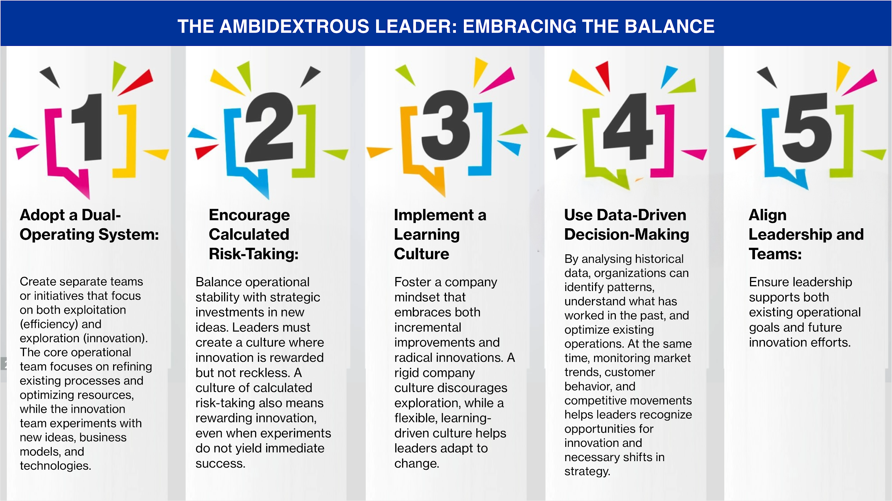

Slide 20
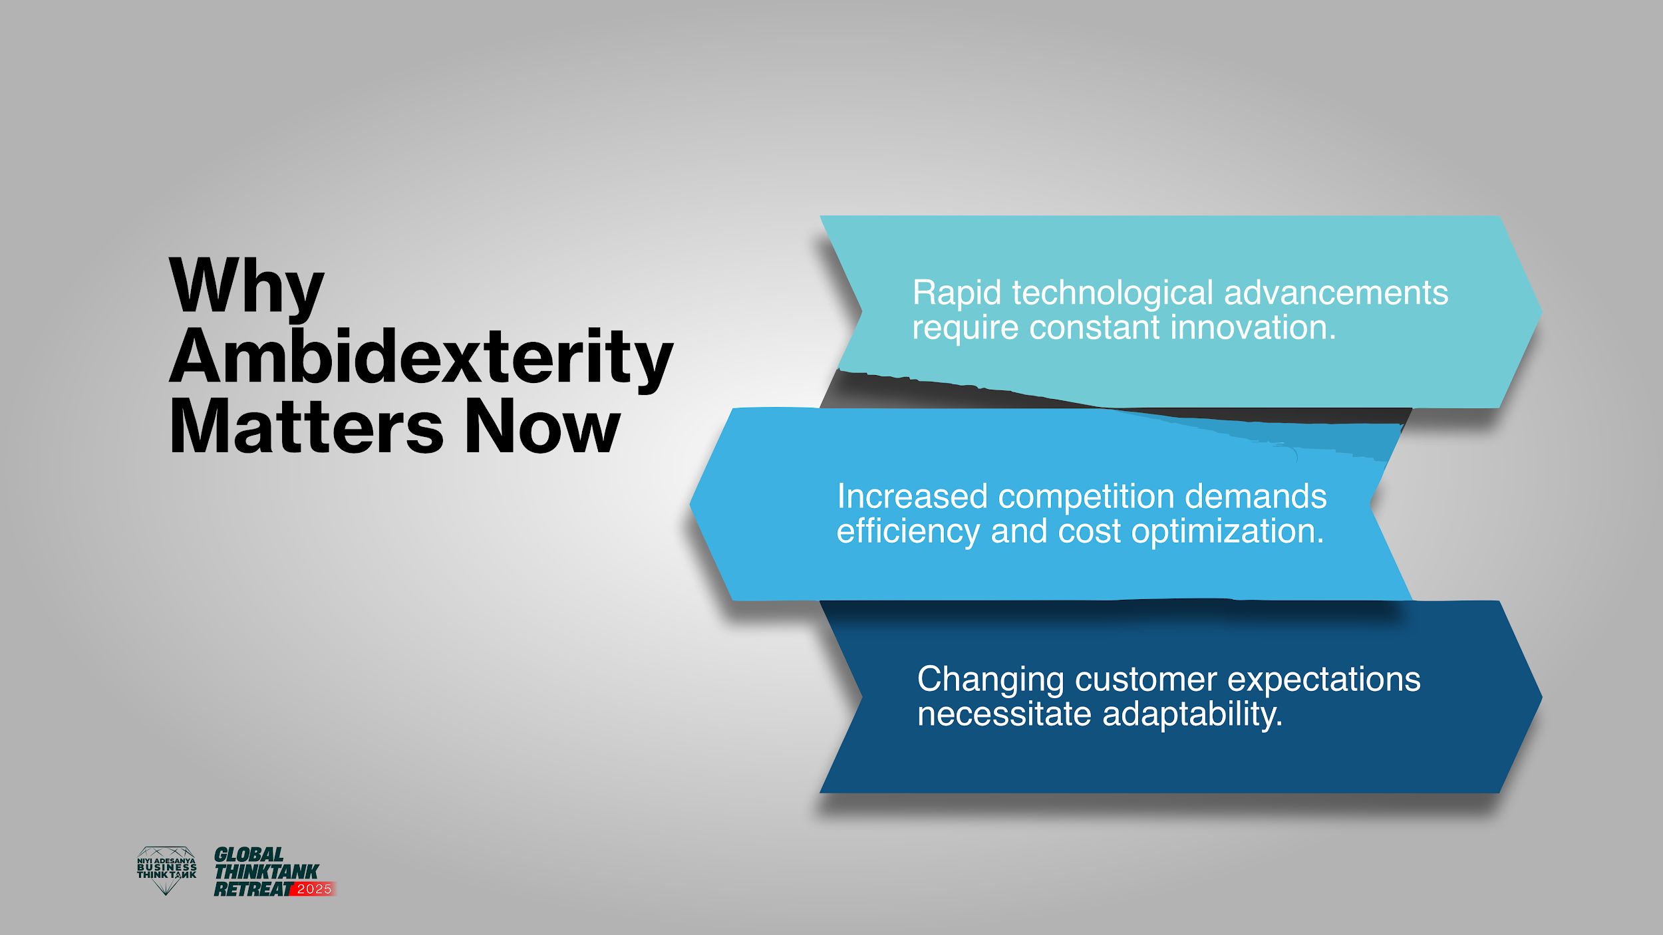

Slide 21
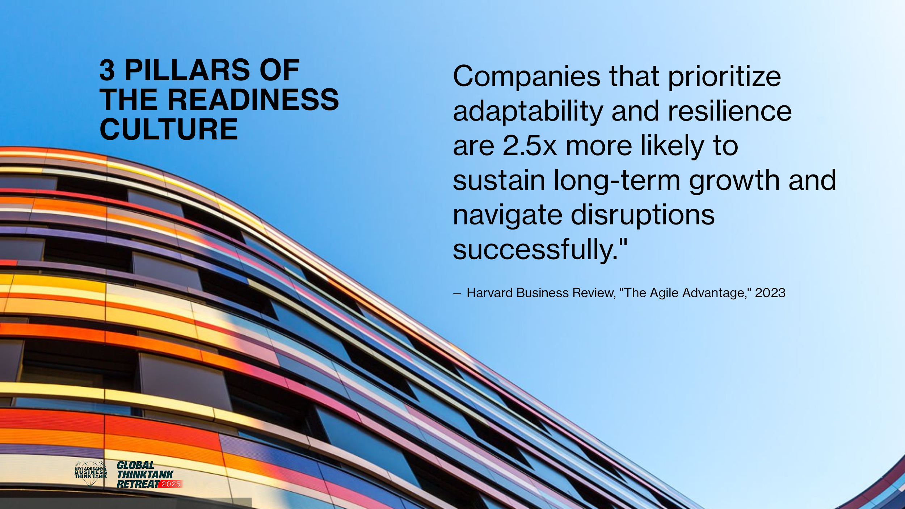

Slide 22
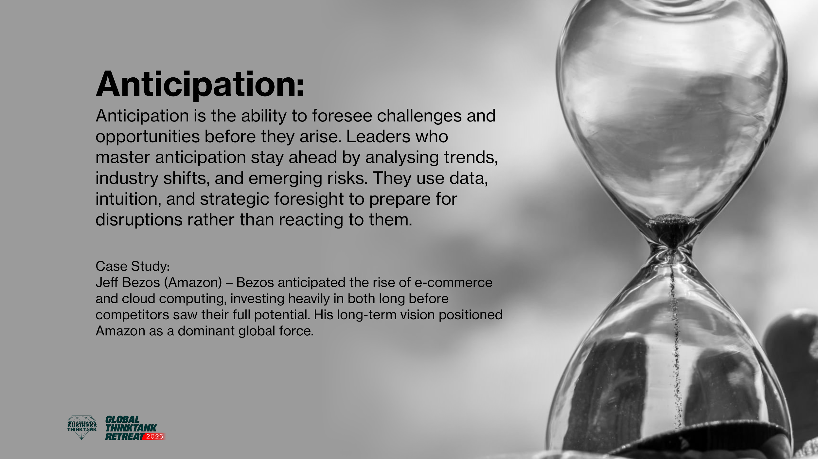

Slide 23
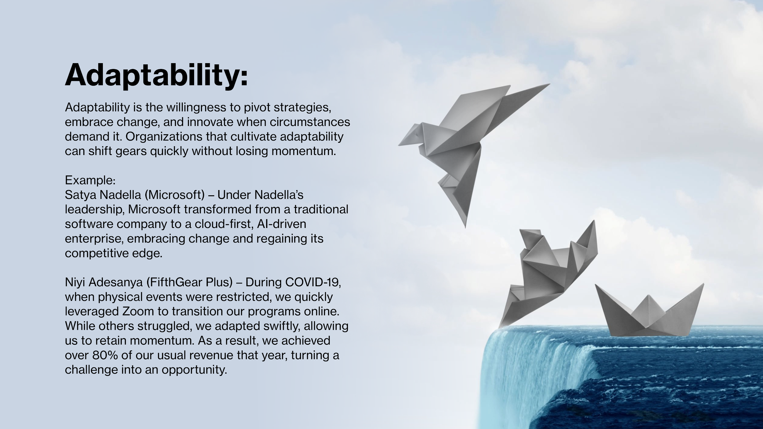

Slide 24
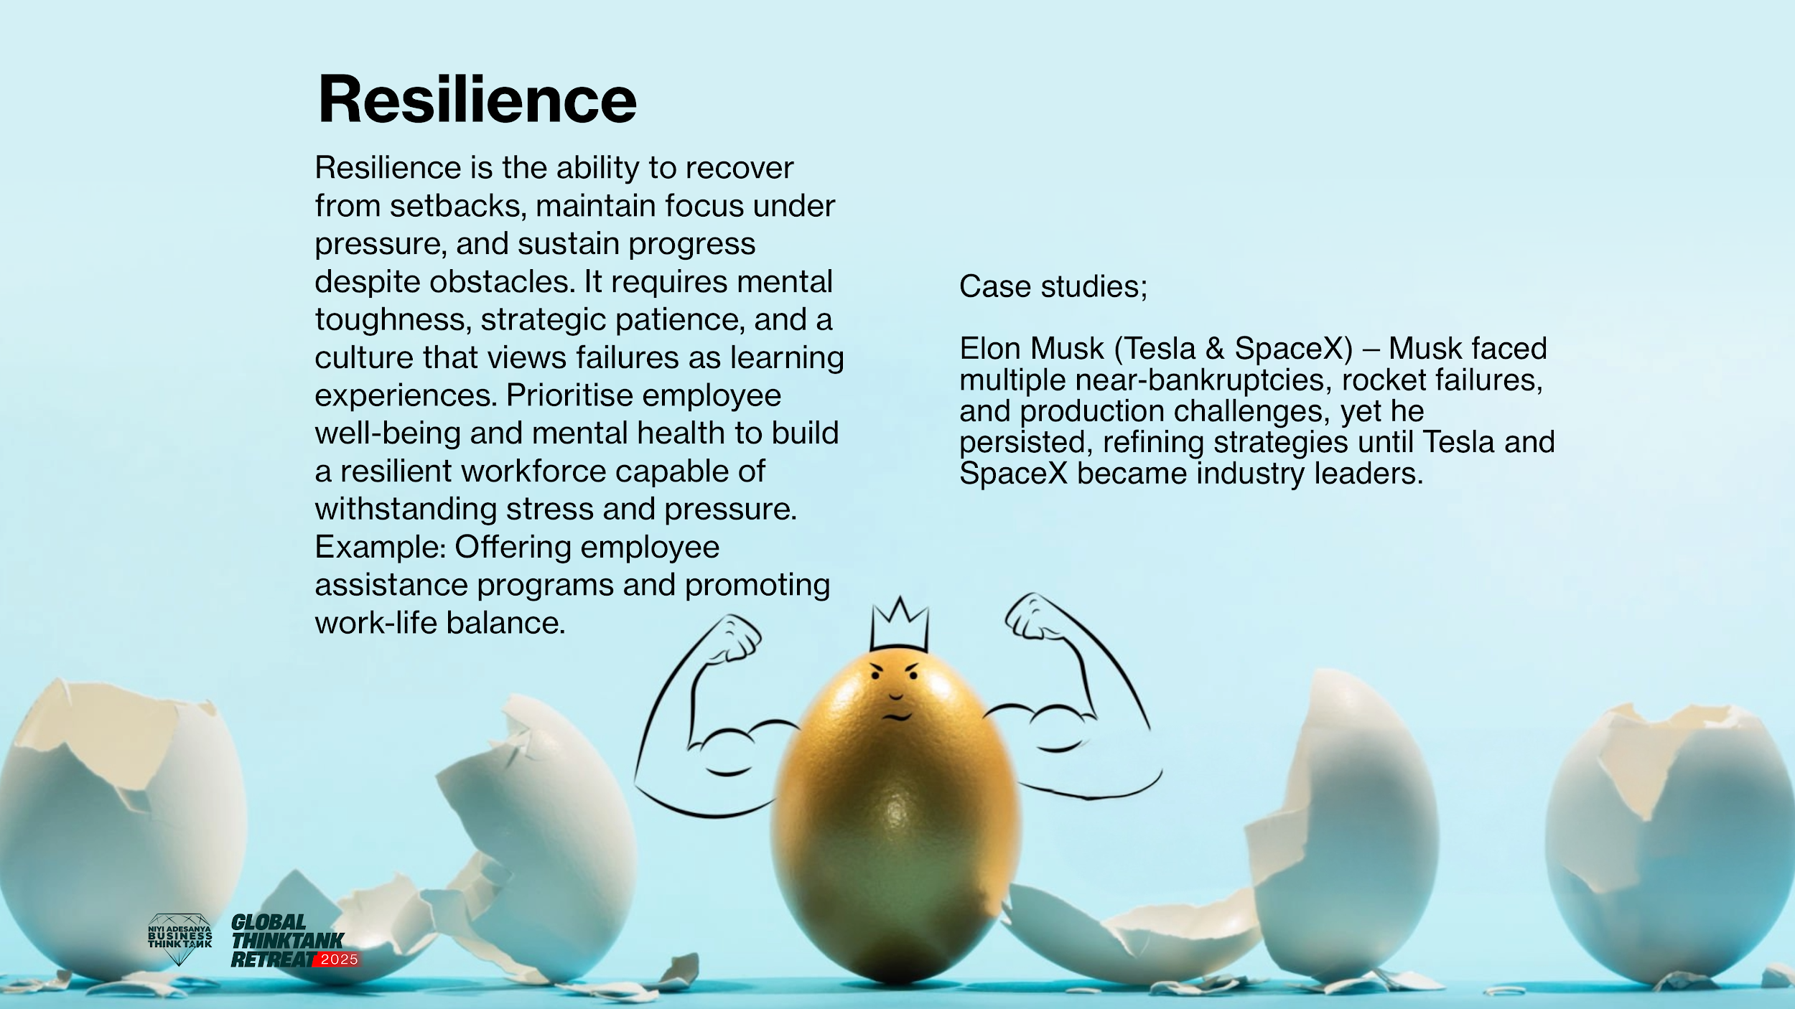

Slide 25


Slide 26
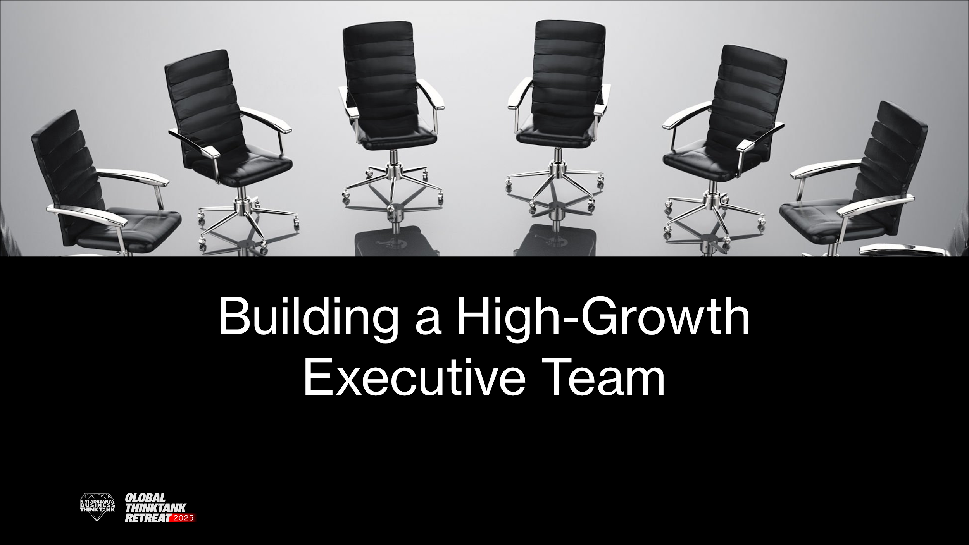

Slide 27
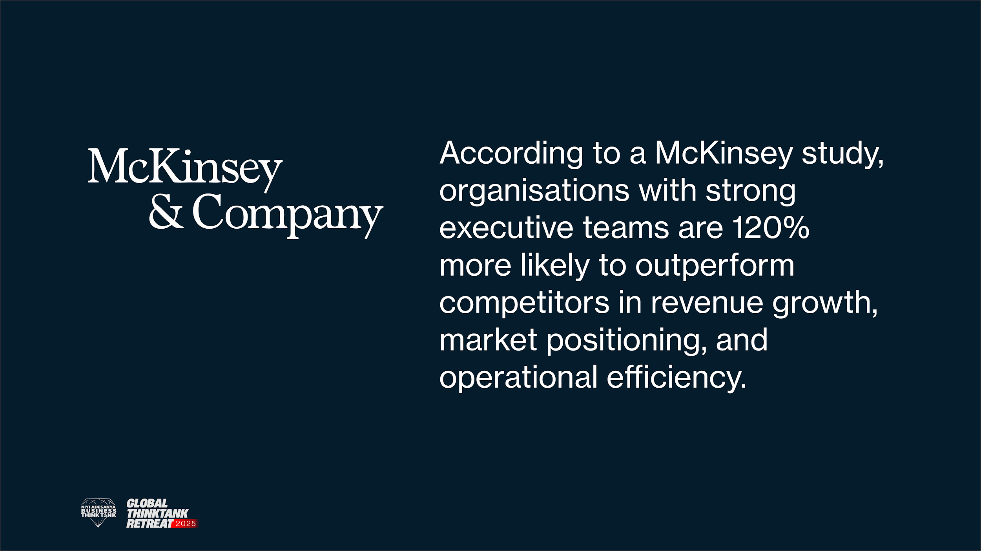

Slide 28
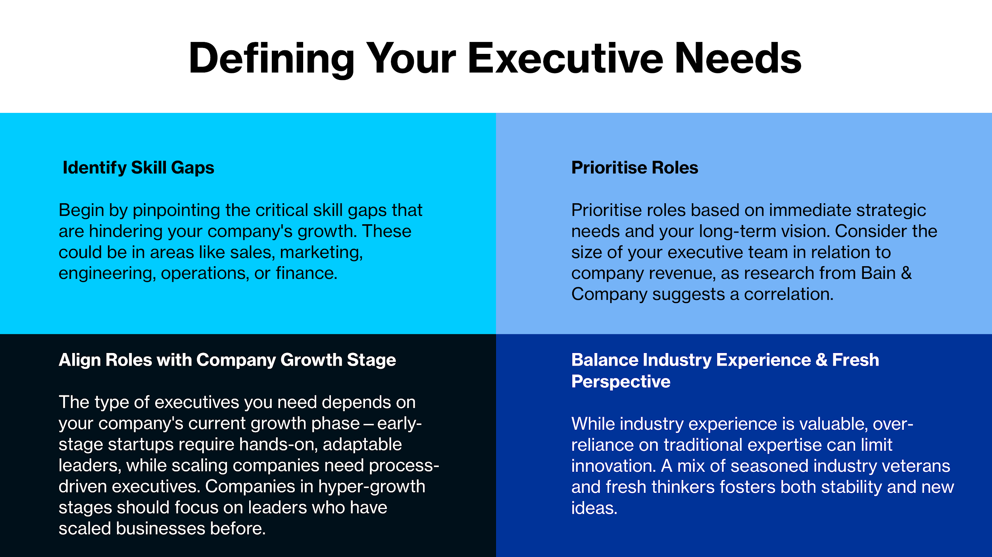

Slide 29
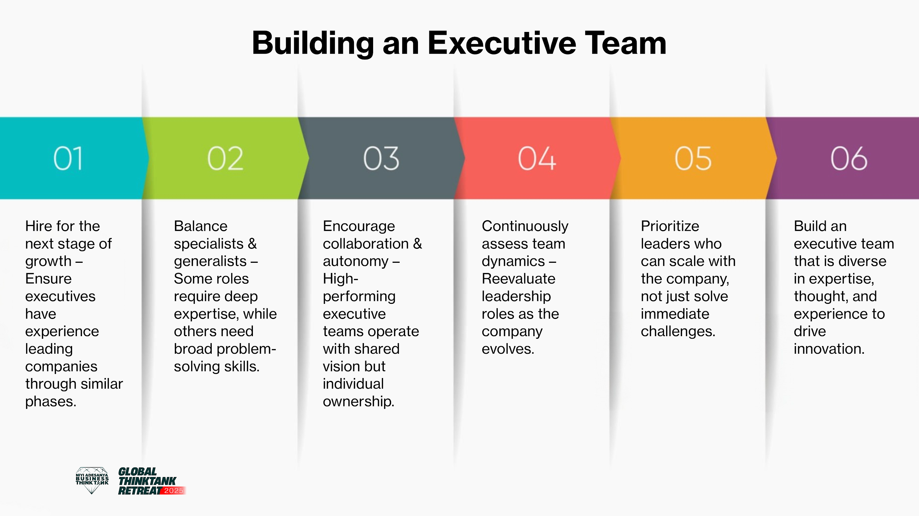

Slide 30
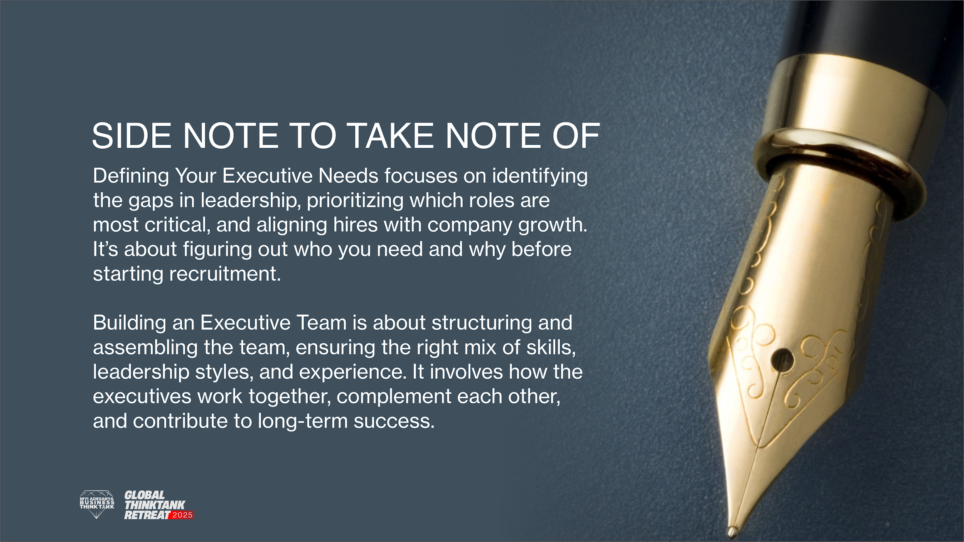

Slide 31
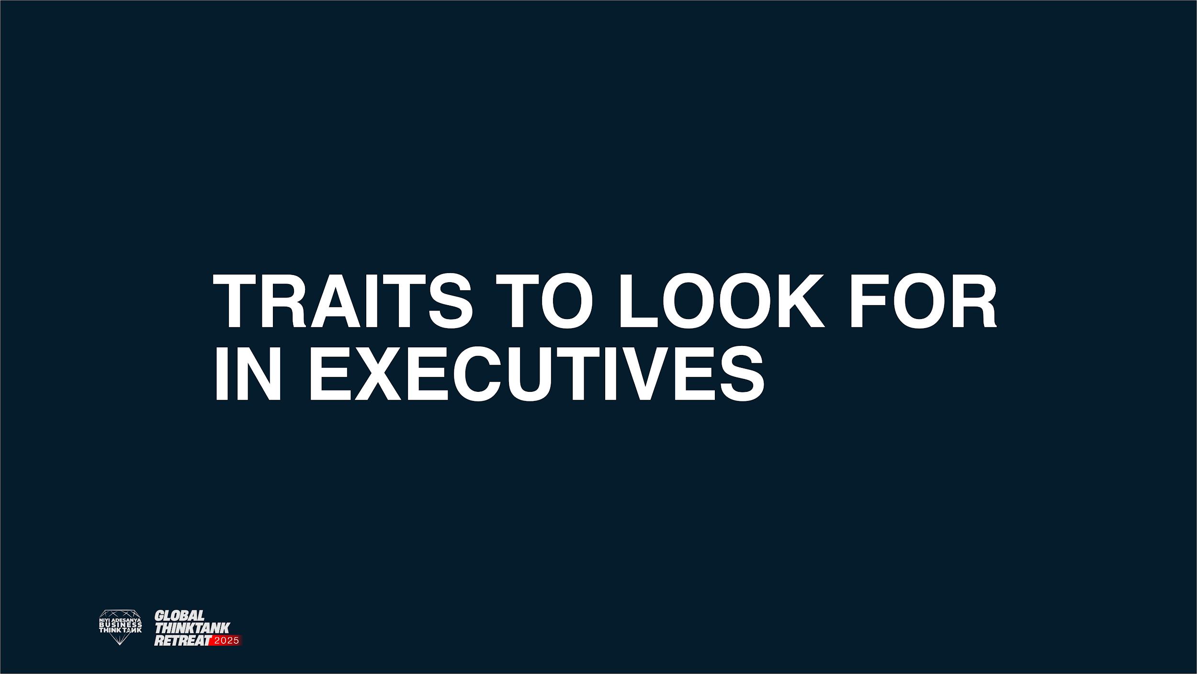

Slide 32

1
Do people in their organization respect their opinions and feel they can learn from them?
Are they right for the current scale and trajectory of your company? You can over-hire for a position, as well as under-hire, given the phase your company is in. For example, do you really need to hire Ruth Porat, Alphabet’s CFO, to manage the finances of your pre-revenue 10-person team?
Functional Area Expertise

Slide 33
2
Can they recruit exceptional people? Can they build a recruiting culture within their team
Do they understand how to build out an organization with multiple layers if needed? How deep of an understanding have they managed in the past, and how does that fit your current needs ( again, 12-18 months here)?
Ability to build and manage a team in those functional areas

Slide 34
3
Can they put a collegial, mutually supportive environment in place for the company as a whole, as well as their function?
Do they try to do what is right for the company even if it is not in their own best interest?
Collegiality:

Slide 35
4
Are they able to understand underlying issues and communicate them within their teams?
Are they able to communicate to the board, external partners or customers, and other major stakeholders?
Strong Communication Skills

Slide 36
5
Do they take ownership of their functions and make sure they are running smoothly and effectively?
Owner Mentality

Slide 37
6
Do they think about how their functions can be a competitive advantage for the company? Most companies are only good at one or two things, which is often enough to be successful. But companies that can tackle more than one thing well tend to outshine everyone else(e.g, Apple with hardware design, supply chain, and marketing)
Are they first principles thinkers? Can they apply their expertise in knowledge in the context of your company, team, and product? Or do they just try to implement exactly what they did in their last role?
Smarts and strategic thinking skills

Slide 38
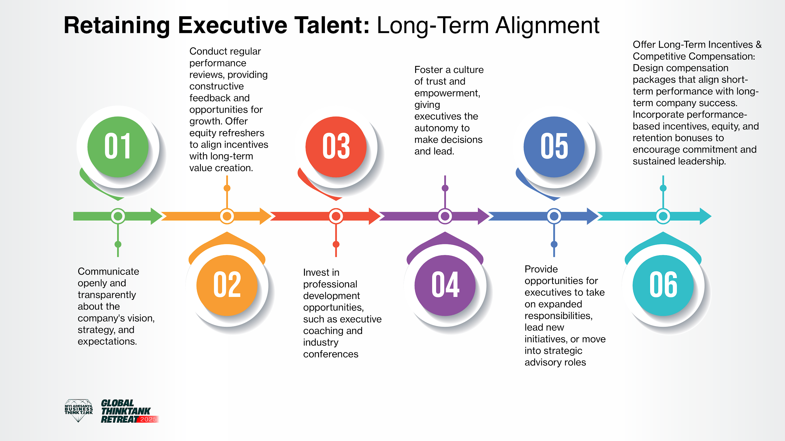

Slide 39


Slide 40
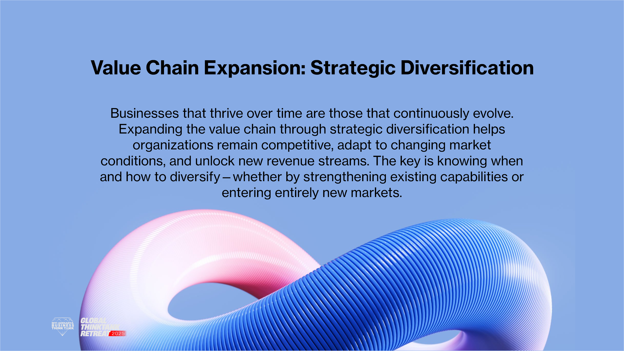

Slide 41
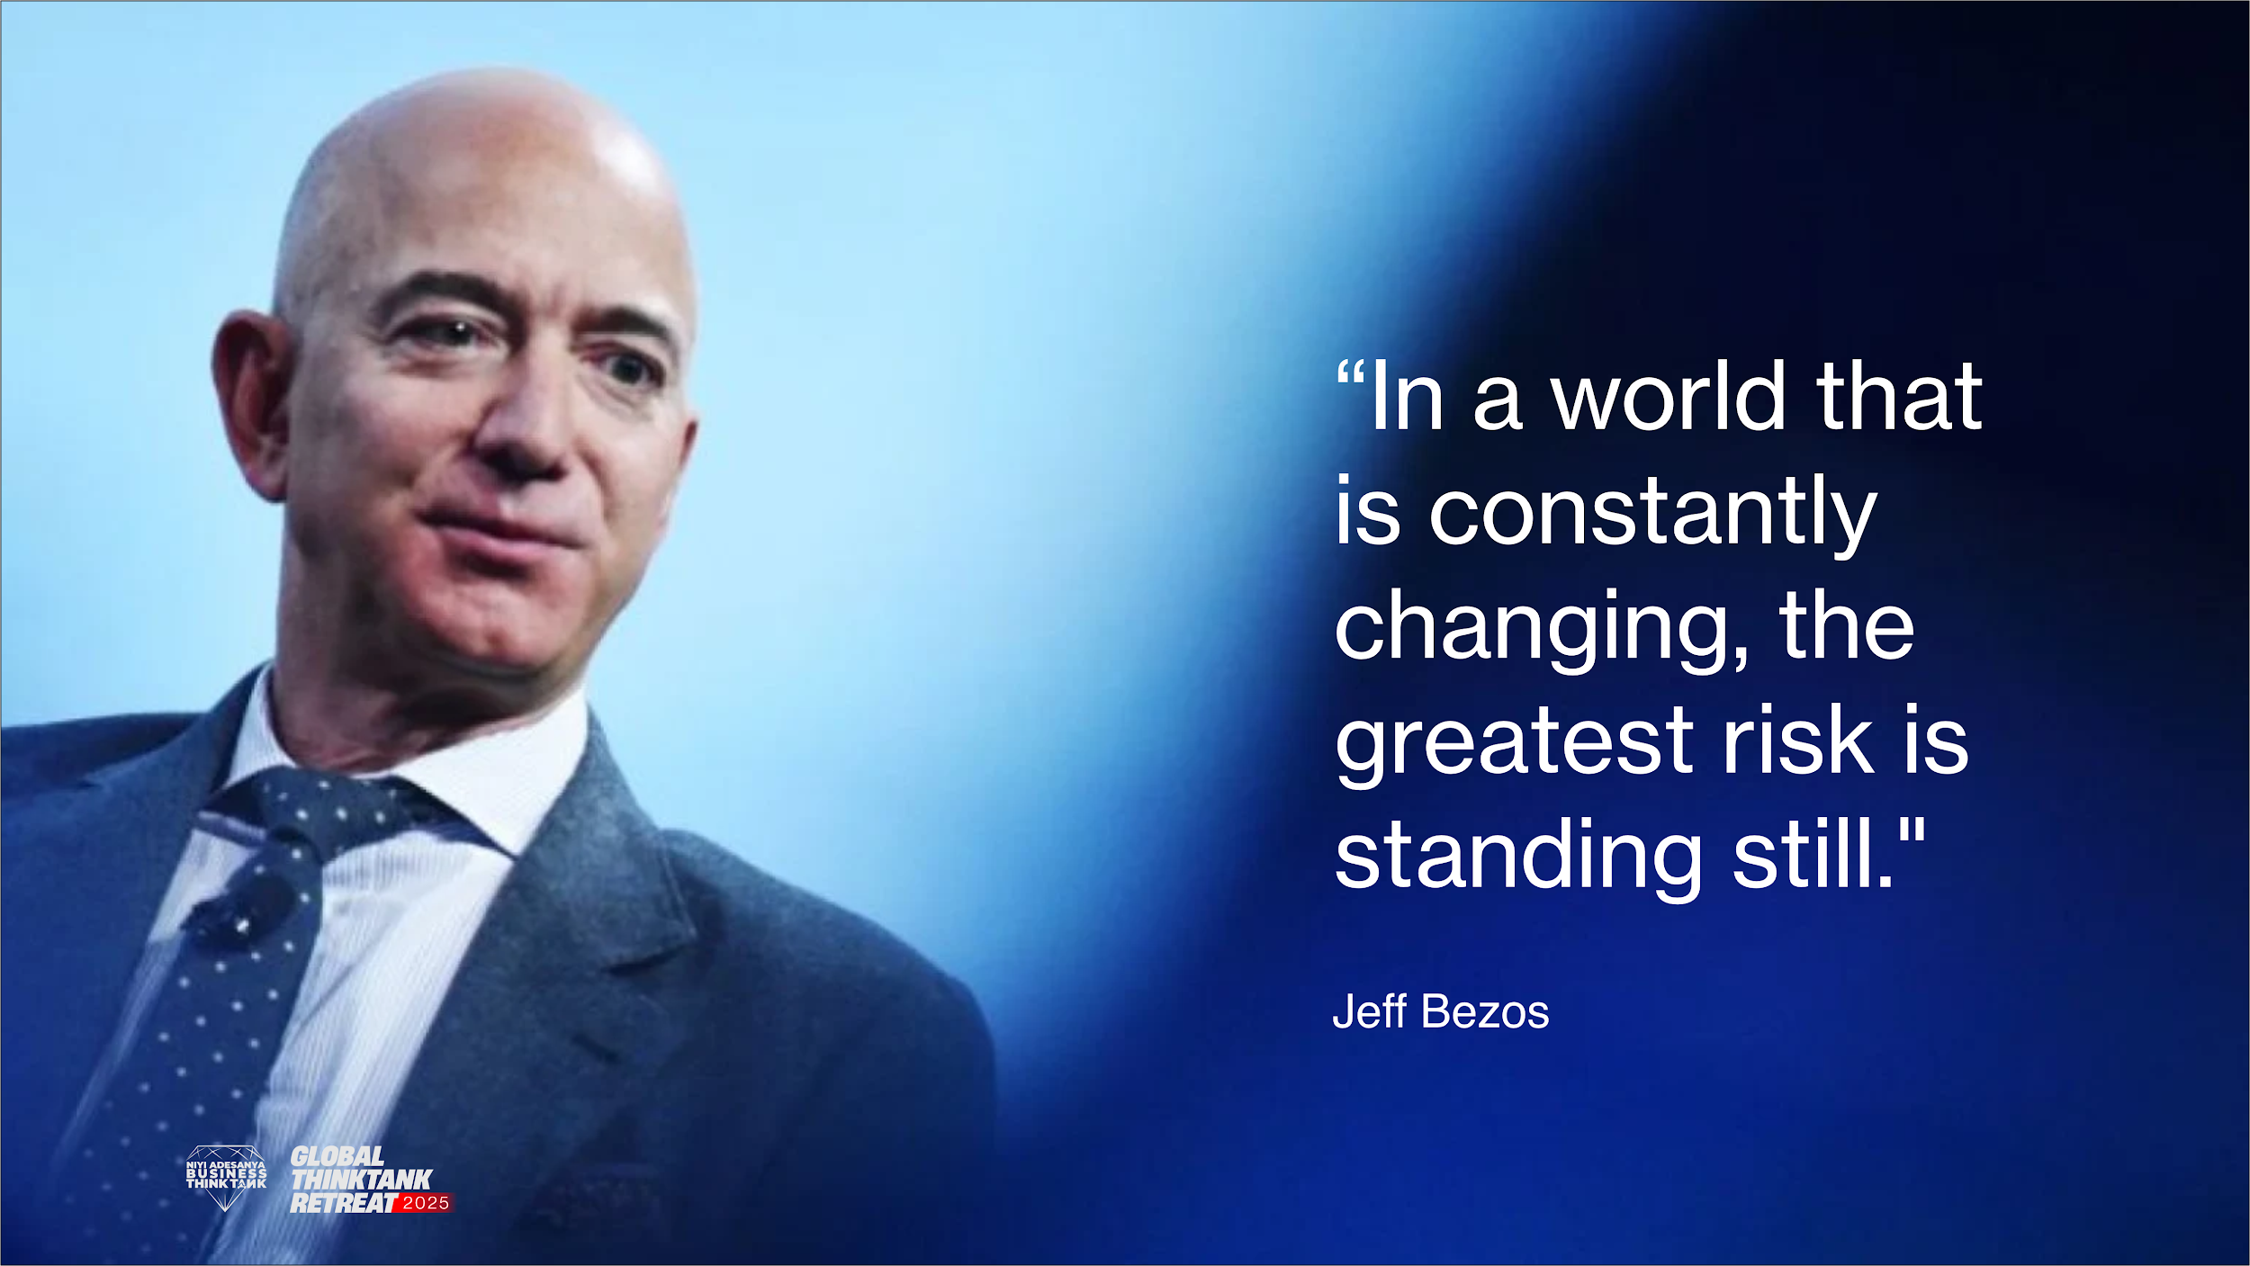

Slide 42
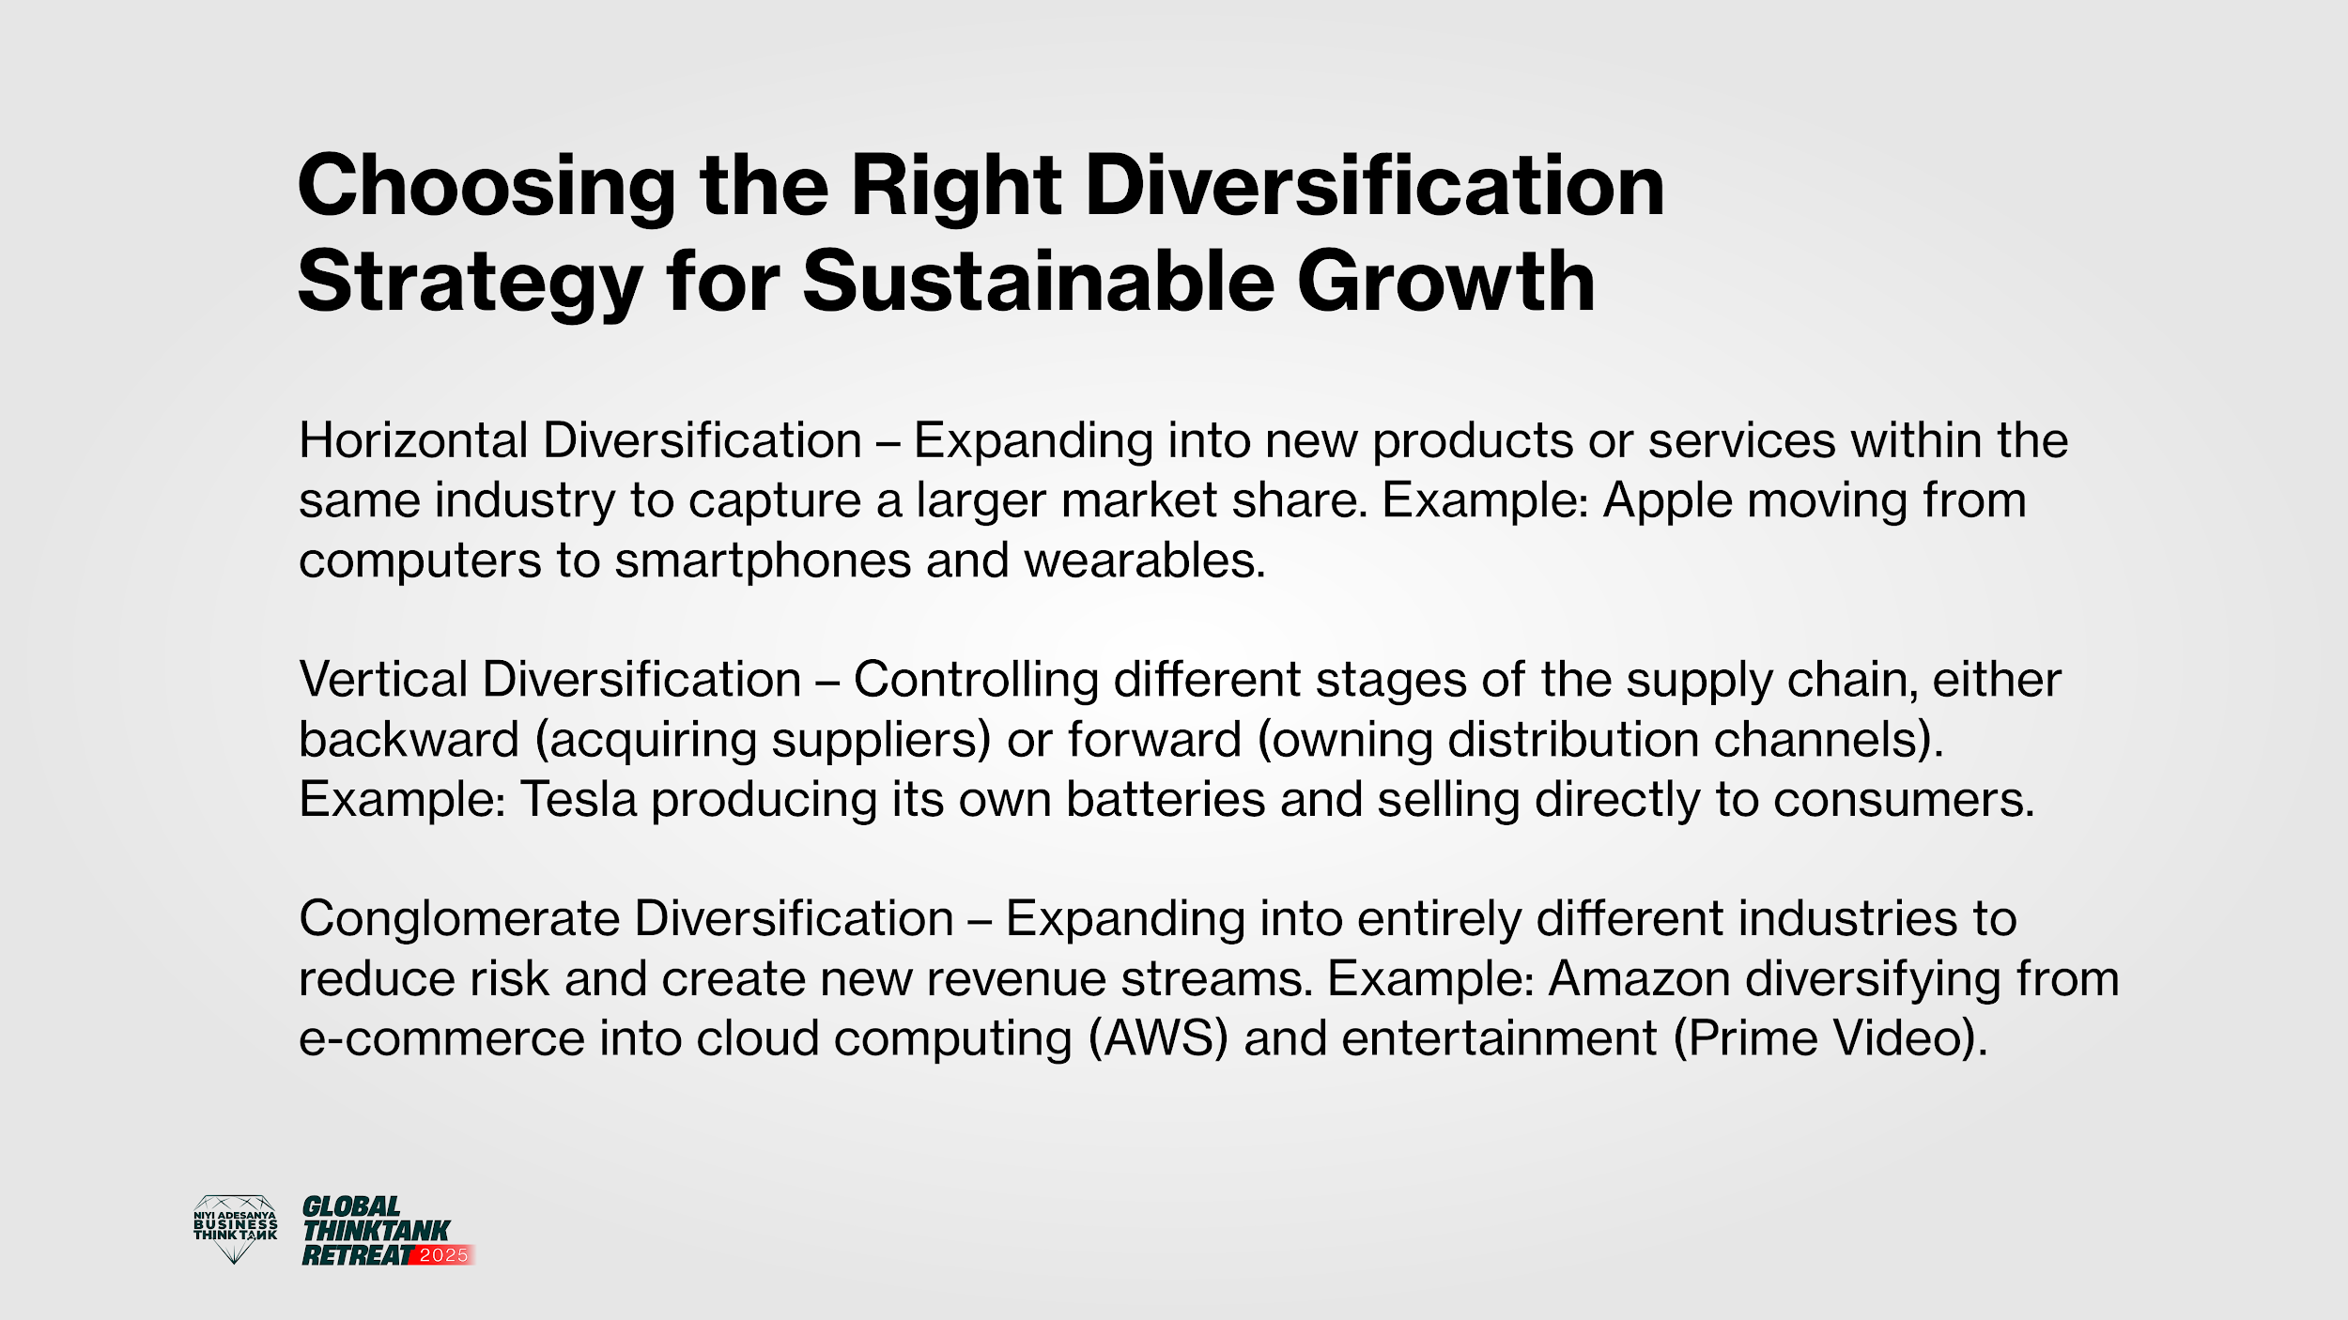

Slide 43
HOW TO DIVERSIFY SUCCESSFULLY
1
2
3
Assess Market Opportunities – Analyse industry trends, customer needs, and competitive gaps.
Choose the Right Diversification Type – Decide between horizontal, vertical, or conglomerate diversification.
Leverage Core Strengths – Expand in ways that align with your existing capabilities and expertise.
4
5
6
Pilot and Test – Start with small-scale implementation before full-scale rollout.
Manage Risk and Resources – Ensure financial and operational readiness for expansion.
Monitor Performance and Adapt – Continuously track outcomes and refine strategies for success.

Slide 44
