Slide 1


Slide 2



WE ALL ARE MINISTERS
It is my utmost pleasure and delight to be here today.
The subject before us is one of profound significance, touching both Faith and Enterprise.
I count it a privilege to share this space with great minds, each carrying a unique expression of God’s calling.

Slide 3
As the foundational speaker at this retreat, I decided to guide us in revisiting some core truths—wisdom that is often overlooked yet divinely revealed.
These insights will empower us to navigate both spheres—the Church and the Marketplace—positioning us for greater influence and impact.

Slide 4
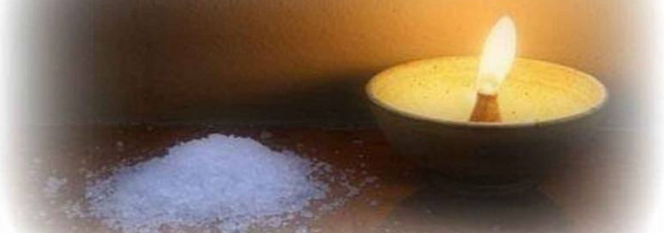
INTRODUCTION
The Church as a whole—both the Pulpit and the Pew—is a divine force, designed by God to be SALT and LIGHT in the world.

Slide 5

Matthew‬ ‭5‬:‭13‬-‭16‬ ‭(MSG‬‬) 13) “Let me tell you why you are here. You’re here to be salt-seasoning that brings out the God-flavors of this earth. If you lose your saltiness, how will people taste godliness? You’ve lost your usefulness and will end up in the garbage.

Slide 6
14-16) “Here’s another way to put it: You’re here to be light, bringing out the God-colors in the world. God is not a secret to be kept. We’re going public with this, as public as a city on a hill.
If I make you light-bearers, you don’t think I’m going to hide you under a bucket, do you? I’m putting you on a light stand. Now that I’ve put you there on a hilltop, on a light stand—shine! Keep open house; be generous with your lives. By opening up to others, you’ll prompt people to open up with God, this generous Father in heaven.”

Slide 7
▪ When Purpose is not known, abuse is inevitable.
Over the years, the Church has largely used Christ for personal gain, operating with a distorted mindset—one that has consumed us entirely.
▪ It is with the intent of change, redirection, and rightful alignment that I see this retreat as deeply pivotal.
▪ Matthew 5:13-16 stands, for me, as a Universal Mandate for the Body of Christ, deeply rooted in God’s original intent for us as His own

Slide 8
His original intent is for us to manifest on earth as:
i) GOD-FLAVORS
ii) GOD-COLORS
influencing both the Church and the Marketplace for lasting impact.

Slide 9

PERSPECTIVES:
THE CHURCH
Mark‬ ‭16‬:‭14‬b-‭20‬ ‭(MSG‬‬) “…he said, “Go into the world. Go everywhere and announce the Message of God’s good news to one and all.

Slide 10
Whoever believes and is baptized is saved; whoever refuses to believe is damned.
“These are some of the signs that will accompany believers: They will throw out demons in my name, they will speak in new tongues, they will take snakes in their hands, they will drink poison and not be hurt, they will lay hands on the sick and make them well.”

Slide 11
Then the Master Jesus, after briefing them, was taken up to heaven, and he sat down beside God in the place of honor.
And the disciples went everywhere preaching, the Master working right with them, validating the Message with indisputable evidence.

Slide 12

Jesus was literally saying, “GO PUBLIC!”
During the briefing session with His disciples before His departure, He was putting all their time together into proper perspective:

Slide 13

GO EVERYWHERE and make My way the lifestyle—not just within the Church, but out in the world.
GO PUBLIC!

Slide 14

Don’t keep the Light confined to the family of God alone.
Be the Light that you are—take your place on the bushels of life and SHINE

Slide 15

Get into the pot of stew the world is cooking and salt it—that is our mandate!
▪ As Salt & Light, our greatest impact is realized (optimized) outside the Church.

Slide 16
The Church Denominations (as numerous as we have them) are intended to BE TRAINING GROUNDS
[i.e EQUIPPING CENTERS].
The Church Denomination is the Mother, who is to NURTURE AND RAISE her children FOR IMPACT both within the nuclear church family, extended family (body of Christ) and the larger world where it is best significant.

Slide 17
THE MARKETPLACE
In reality, Jesus never intended for there to be a divide between home and public spaces when it comes to our expressions and performance.
Yet, the unfortunate reality is that many Christians are Christ-followers only on Sundays or whenever they are in church circles. Outside of that, they see themselves primarily as entrepreneurs, career professionals, or people in governance, using different metrics to navigate these spheres. But from the beginning, “it was not so.” This was never God’s idea.

Slide 18
One of the greatest undoings of the laity is the misconception of preaching—a misunderstanding that has caused many to lay back instead of being proactive, as the Master instructed.

Slide 19

Preaching means passionately advocating for or spreading a message, idea, or belief—influencing others through persuasion, instruction, or inspiration.

Slide 20
Yet, it has been largely perceived as the exclusive job of the pulpit, seldom that of the pew. Because of this, our Light has remained within the Body, and our Salt has been poured into already salted pots.
Instead of being God-Colors and God-Flavors, we have allowed the world to become blurry and tasteless.

Slide 21
Matthew 5:13b (MSG) says If you lose your saltiness, how will people taste godliness? You’ve lost your usefulness and will end up in the garbage.

Slide 22
Regrettably, the Church is gradually closing in on itself like garbage—a truly sad reality!
That is why the initiative behind this retreat is not just timely but absolutely necessary for such a time as this.
Thanks to the Visionary, Niyi Adesanya, for leading this charge.

Slide 23
WAY FORWARD!
This Pastors Think Tank Retreat is a clarion call—the blaring wake-up alarm for both the Pulpit and the Pew.
Matthew 5:15&16 (MSG) says==> God is not a secret to be kept. We’re going public with this, as public as a city on a hill.

Slide 24
If I make you light-bearers, you don’t think I’m going to hide you under a bucket, do you? I’m putting you on a light stand. Now that I’ve put you there on a hilltop, on a light stand—shine! Keep open house; be generous with your lives.
By opening up to others, you’ll prompt people to open up with God, this generous Father in heaven.”

Slide 25
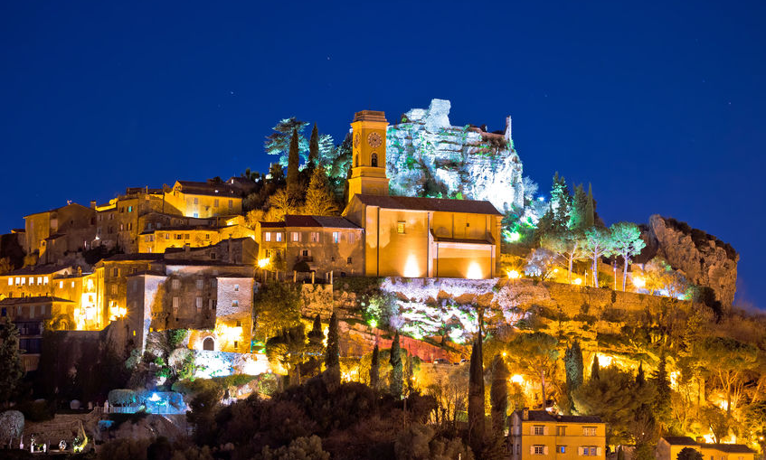
WE ARE GOING PUBLIC WITH THIS, AS PUBLIC AS A CITY SET ON THE HILL.

Slide 26
Beyond our role as shepherds, we as Pastors are key drivers of economic and social impact.
We must take the bull by the horn—doing much more than ever before—by embracing our role in invasively influencing the Marketplace.
Our crusade is to entrench and infect the Marketplace with Kingdom values until it becomes the default way of life.

Slide 27
Our messages, strategies, and structures should be tailored to feed this mission, with subjects like integrity, servant leadership, entrepreneurship, financial literacy & investment and ethical business practices at the forefront.
—We must teach believers that work, leadership, and business are platforms for Kingdom influence—these are their ‘Pulpit’ from which they preach, teach, influence, inspire, and impact. This is their stand, where they open up to others and SHINE!

Slide 28

IN CLOSING
I can’t wrap this up without mentioning that women have always been—and will continue to be—key players in molding both the Church and the Marketplace

Slide 29
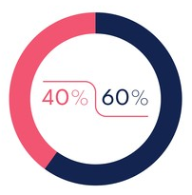
Statistics show that women account for about 60% of church attendance/membership, while men represent 40%

Slide 30
The same balance may not exist in the realms of entrepreneurship, careers, and governance—as observed within the MSMEs, the very sphere where I minister—but women still make up roughly 40%. This indicates that we cannot ignore women if the Church is to have an immersive impact on the Marketplace.

Slide 31
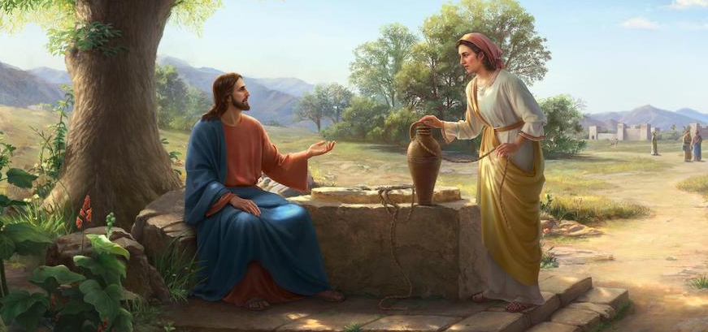
Women are powerful evangelists, taking a cue from the Samaritan woman at the well. Figures like the Proverbs 31 Woman enrich many sectors of our economy, while leaders such as Deborah and Esther are fast emerging in governance and policy.

Slide 32
In the spirit of this March’s global focus on Women, I urge the Church to pay closer attention to Women —nurturing and developing their skills, empowering them financially, and strengthening them spiritually so they can occupy their pivotal place in God’s end-time agenda.

Slide 33

Pastors, please listen—give your ears and your heart: ignoring or suppressing a woman in your congregation is counter to God’s agenda.

Slide 34
Indeed it is invaluable wisdom to influence and inspire the women in your congregation or in your sphere, helping them trace their path and find their footing in their God-ordained space. Your crown in heaven will be beyond measure.
I must say this is not a beggarly appeal but a bold declaration of God’s will for these end times.

Slide 35

TO THE CHURCH AND THE MARKETPLACE:
It is time to position ourselves as the LIGHT on the STAND—not as a blurry or hidden light.

Slide 36
